Slide 1
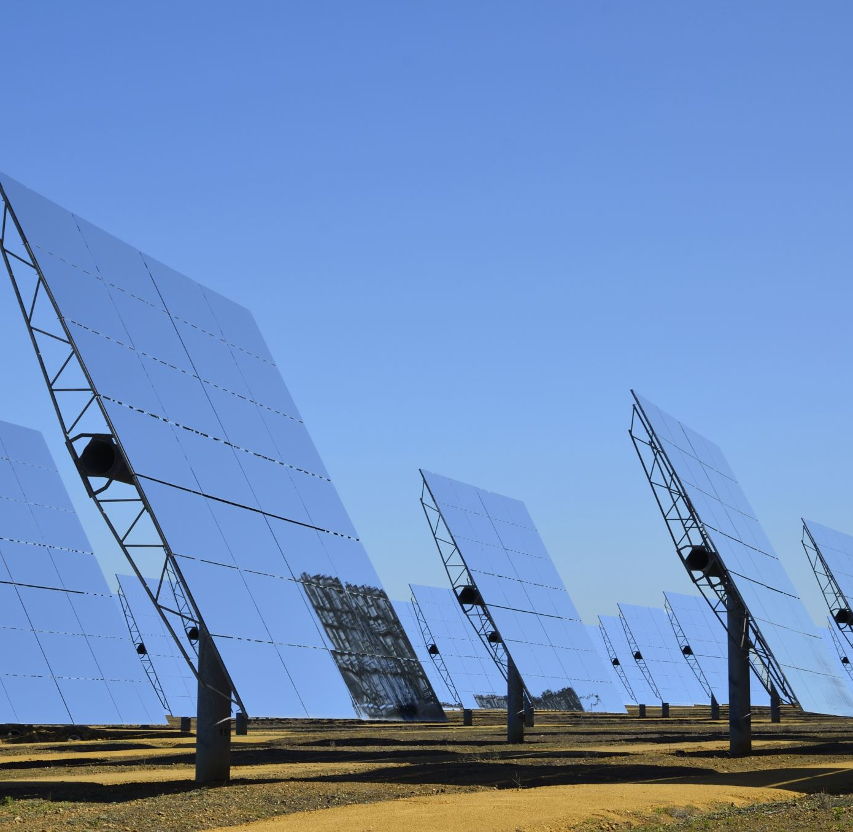
Photovoltaic Hosting Capacity of Feeders

Slide 2

Our Objective is to find photovoltaic (PV) hosting capacity of a power distribution network considering the number of PV injection nodes
For this Project we will use Daily simulations using MATLAB and OpenDSS
Our Case study will be on the IEEE 123-node distribution feeder
We are trying to observe that what are the limits of our system can be.

Slide 3

INTRODUCTION
In the last decade, distributed energy sources (DERs) are commonly used in power distribution systems.
As the price of renewable energy sources has decreased, the integration of renewable energy sources into the distribution feeders has increased especially PV systems.
When we consider the total energy generation from renewable energy is increasing by %2.9 every year [1] Therefore, such an applications are important for the future.
In light of the information above, it is important to determine the maximum permissible PV power injection into the feeders.

Slide 4
What is Hosting Capacity
Hosting capacity is defined as the total PV that can be injected on a given feeder without any feeder upgrades or modifications.
Hosting capacity is referred as the maximum PV size that does not violate any operating constraints when PVs are connected to any valid node on the feeder. [2]
In fact, these definitions of hosting capacity incorporates that the voltage magnitudes at load nodes in the feeder should remain within the ANSI standards. The research shows that the maximum permissible voltage rise is 1.05 p.u. in USA according to ANSI standarts.[3]

Slide 5
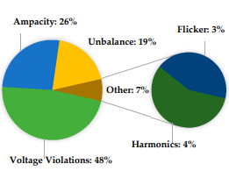
Percentages of the statistics of PV HC limiting factors in literature showing voltage

Slide 6
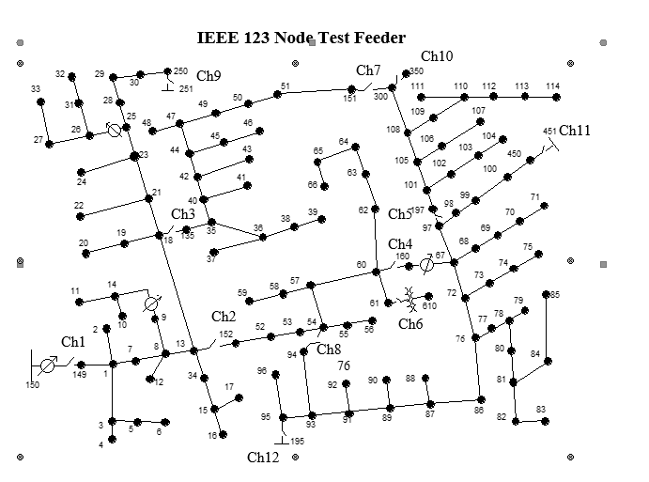
Case Study

Slide 7
OUR OBJECTİVES
We are trying to determine PV hosting capacity in distribution feeders.
The first thing we do is to randomly select the candidate PV locations.
We will make same several power flow analyses with randomly chosen PV injection
Then, we increased the PV output gradually. The output will start from 3kW to 300kW.
After the steps are specified, we run the simulation and we record maximum voltage deviations.

Slide 8
The Algorithm Steps
1-) Randomly generate 10 node points to inject the PVs
2-) Add PVs to these randomly generated points
3-) Apply Daily power flow soluiton
4-) Take the maxiumum phase voltages and keep overflow situations (>1.05 PU) with PV Powers and randomly generated locations.
5-) Increase the PVs power and go to the 2nd step
6-) Plot the phases maximum values and see the general behaviour.

Slide 9
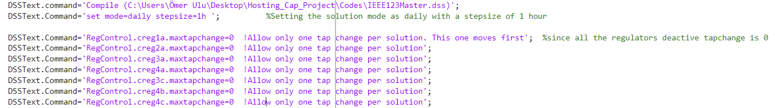
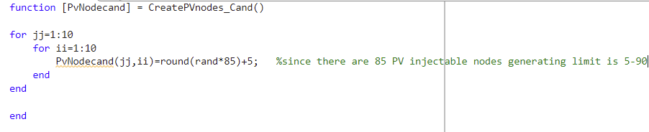
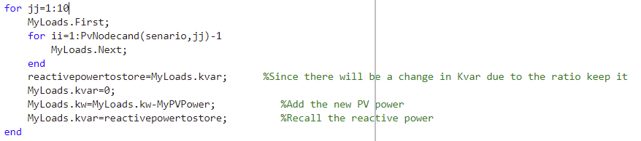
The Algorithm:
Set the solution mode as Daily and make regulators deactive:
Generating the node points randomly for 10 senarios:
Add PVs to the points for the senarios:

Slide 10
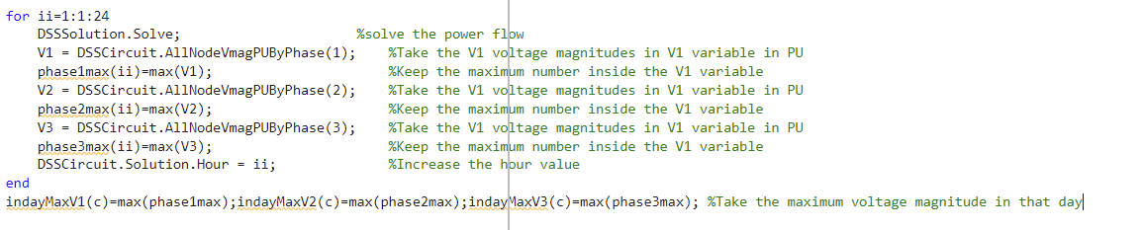
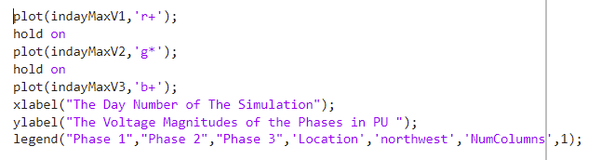
Starting the Daily solutions hour by hour and keep the maximum point in that day:
Plotting the values:

Slide 11
Outputs Of The Code of Senario Sample 1

Slide 12
Outputs Of The Code of Senario Sample 2

Slide 13

CONCLUSION
This work has been done to determine PV hosting capacity of the power distribution systems and observed maximum voltage deviations using MATLAB and OpenDSS environments.
We can see from the simulation result, the increasing distributed power of the PV panels in the power distribution network, the number of overflow situations significantly increased. So we should know the limits of our system.

Slide 14
REFERENCES
[1] “International energy outlook 2016,” Electric Power Research Institute for U.S. Energy Information Administration., Tech. Rep. 000000003002004777, May 2016. [Online]. Available: http://www.eia.gov/forecasts/ieo/pdf/0484(2016).pdf
[2] J. Seuss, M. J. Reno, R. J. Broderick, and S. Grijalva, “Improving distribution network pv hosting capacity via smart inverter reactive power support,” in Proc. IEEE PES General Meeting, July 2015, pp. 1–5.
[3] Review on the PV Hosting Capacity in Distribution Networks by Samar Fatima, Verner Püvi and Matti Lehtonen, Energies 2020, 13(18), 4756; https://doi.org/10.3390/en13184756
[4] O. Ceylan, S. Paudyal, B. P. Bhattarai and K. S. Myers, "Photovoltaic hosting capacity of feeders with reactive power control and tap changers," 2017 IEEE PES Innovative Smart Grid Technologies Conference Europe (ISGT-Europe), 2017, pp. 1-6, doi: 10.1109/ISGTEurope.2017.8260243.

Slide 15

THANK YOU

